Slide 1
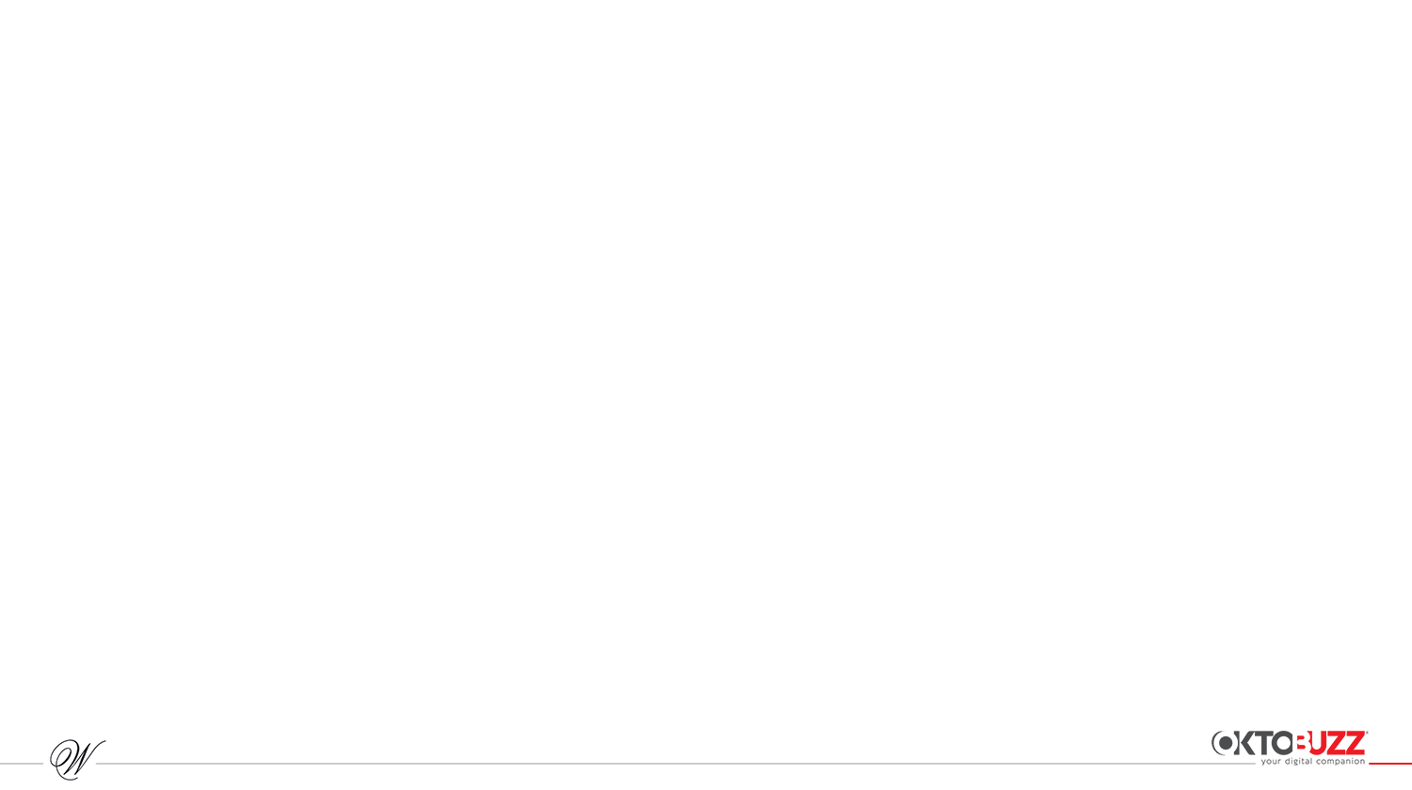

Weekly Report
Date: 14th Jan- 20th Jan 2026

Slide 2
Index
Platforms we use Overview:
- Facebook
- Instagram
- Linkedin
- YouTube
Competition Analysis
Learnings and Recommendations

Slide 3
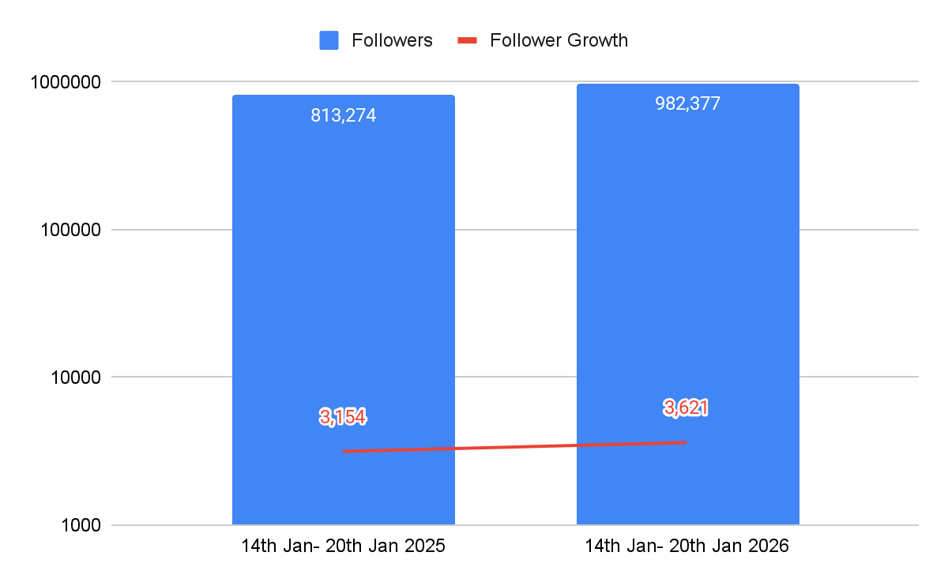
Follower Growth Comparison (Instagram) 2025 - 2026
Inference: Year-over-year follower growth recorded a strong uplift this week, driven by improved content performance, newness, and Sale-led content that resonated well with audiences.
Date: 14th Jan- 20th Jan 2026

Slide 4
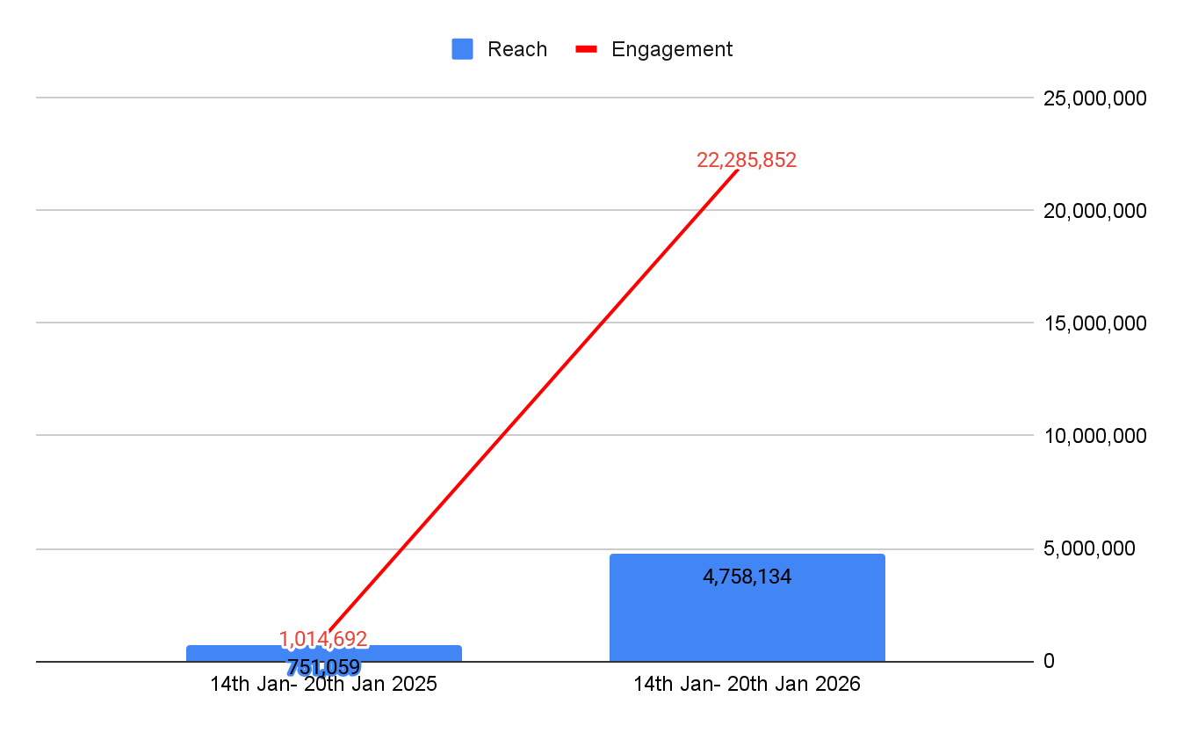
Reach and Engagement with Video Views Comparison (Instagram) 2025 - 2026
Inference: The year-over-year increase in reach and engagement was driven by higher video views, with Sale-led content delivering the highest impact, reaching up to 18M views, while the Wedding Sprint campaign also performed strongly.
Date: 14th Jan- 20th Jan 2026

Slide 5
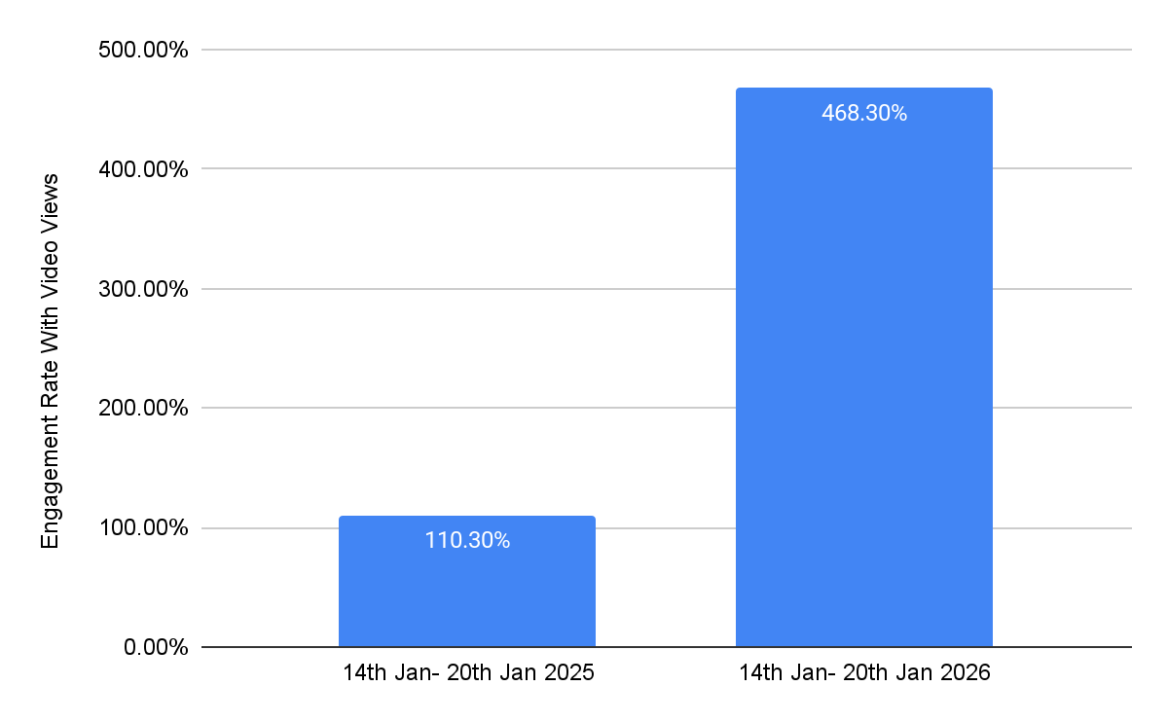
Engagement Rate with Video Views Comparison (Instagram) 2025 - 2026
Inference:
Inference: Year-over-year performance showed a clear uplift, driven primarily by Sale-led content that reached a wide audience, with the wedding sprint campaign also delivering strong result.
Date: 14th Jan- 20th Jan 2026

Slide 6
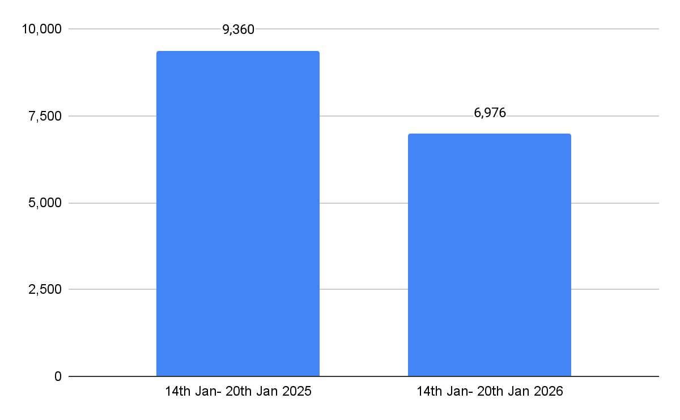
Link Clicks Comparison (Instagram) 2025 v/s 2026
Inference: Link clicks declined this period, indicating an opportunity to strengthen user intent and improve click-through performance through more compelling Tap-to-Shop stories.
Date: 14th Jan- 20th Jan 2026

Slide 7
Followers Growth
Follower Growth counted Manually : {{IG_FOLLOWER_GROWTH}}
Note: Follower growth data was manually extracted as the Instagram dashboard is not showing weekly growth insights.
Extracted : 20th January 2026 | 12 PM
Date: {{REPORT_DATE_RANGE}}

Slide 8

Instagram

Slide 9
Instagram Page Analysis Summary
Particulars | 7th Jan- 13th Jan (Previous Week) | 14th Jan- 20th Jan (Current Week) | Growth
Instagram Posts | Stories | 12|44 | 9|42 | -3|-2
Page Followers | 978,756 | 982,377 | +3,621
Total Reach | 2,340,187 | 4,758,134 | +2,417,947
Total Engagement | 1,913,649 | 22,285,852 | +20,372,203
Video Views | 1,871,510 | 22,222,291 | +20,350,781
Story views | 1,051,932 | 1,091,063 | +39,131
Engagement Rate without Video Views | 1.8% | 1.3%
Engagement Rate with Video Views | 81.7% | 468.3%

Slide 10
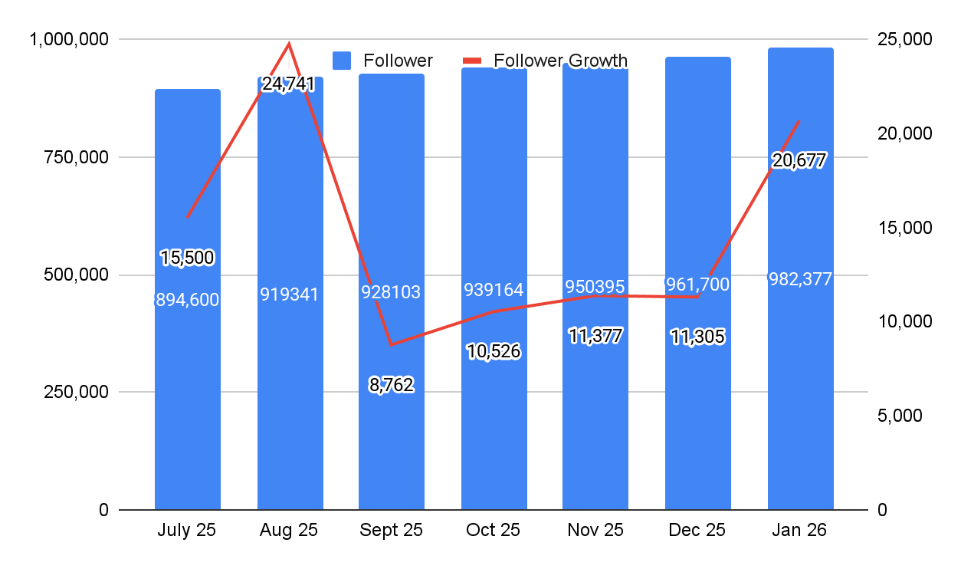
Month on Month Follower Growth Chart (Instagram)
Inference: January recorded a strong increase in new followers, reflecting steady and positive audience growth. This momentum was primarily driven by Sale-led content, along with the Wedding Sprint and modern man, which successfully captured audience interest.
.
Date: 1st Jan- 20th Dec 2026

Slide 11
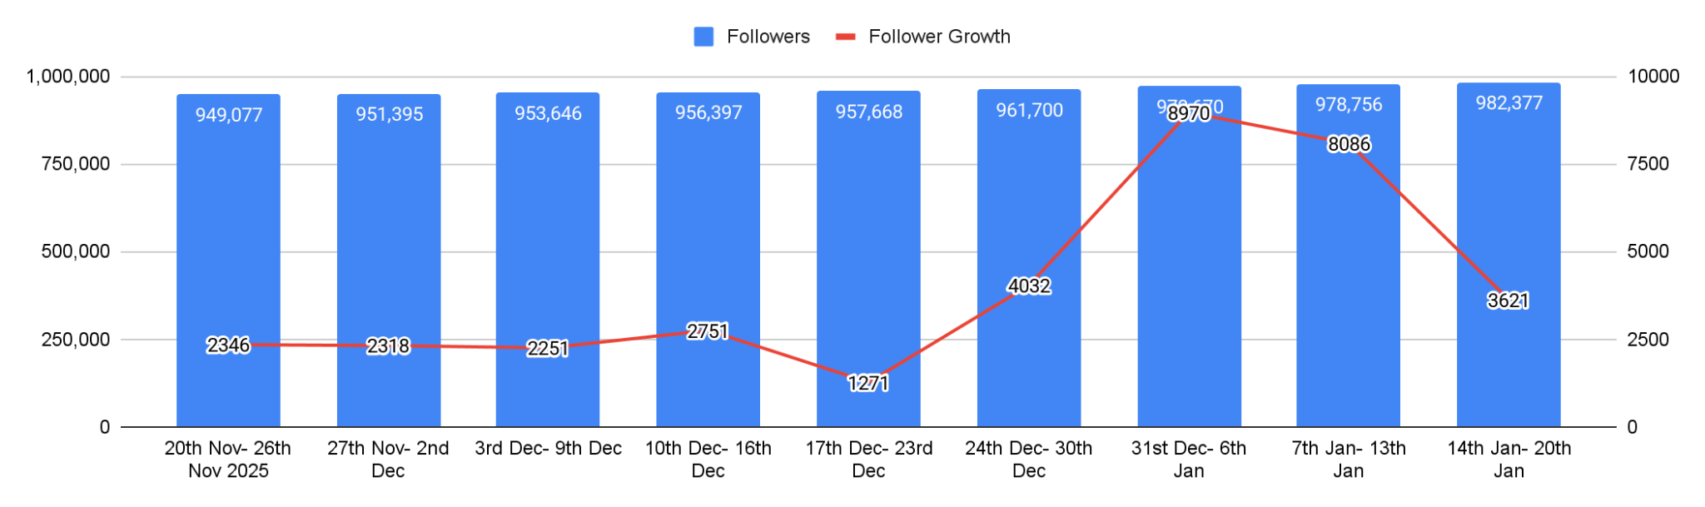
Week on Week Follower Growth Chart (Instagram)
Inference: Weekly follower growth declined, likely due to lower content volume; however, growth is expected to rebound with the rollout of Nuonflex content.
Date: 14th Jan- 20th Jan 2026

Slide 12
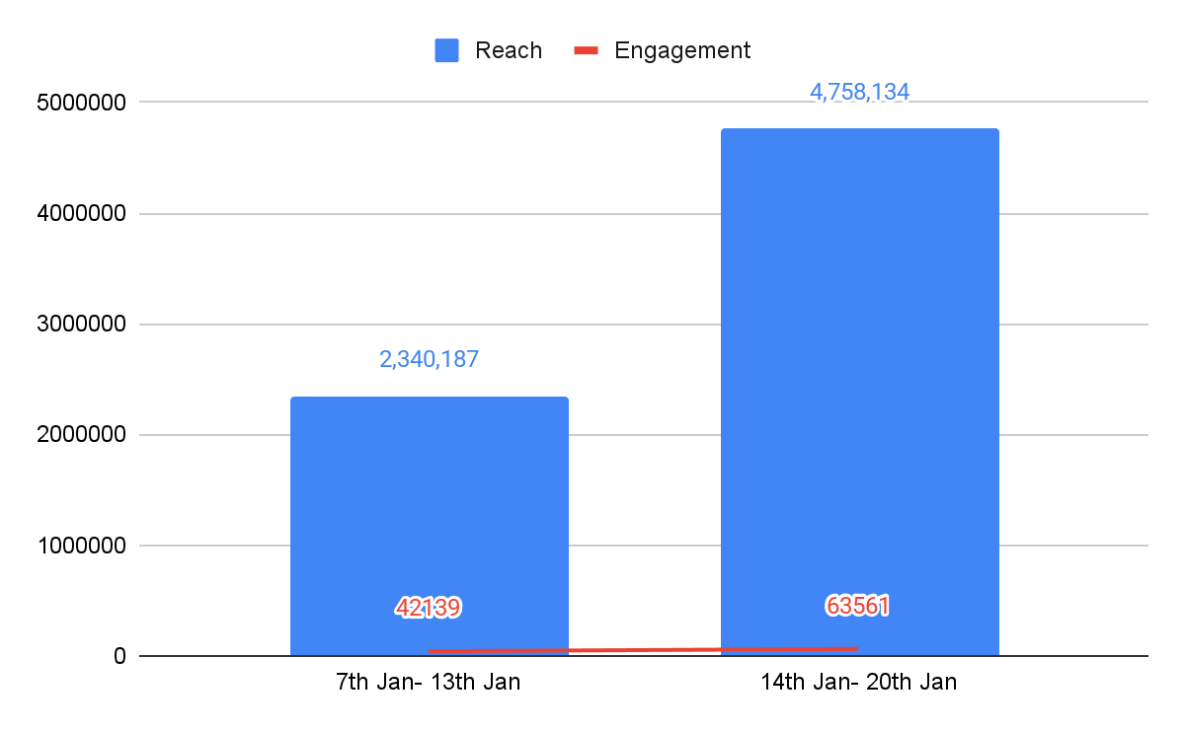
Reach and Engagement without Video Views
Inference: Reach and engagement grew significantly this week, indicating strong content performance, driven primarily by Sale-led content, wedding sprint and modern man that resonated well with audiences.
Date: 14th Jan- 20th Jan 2026

Slide 13
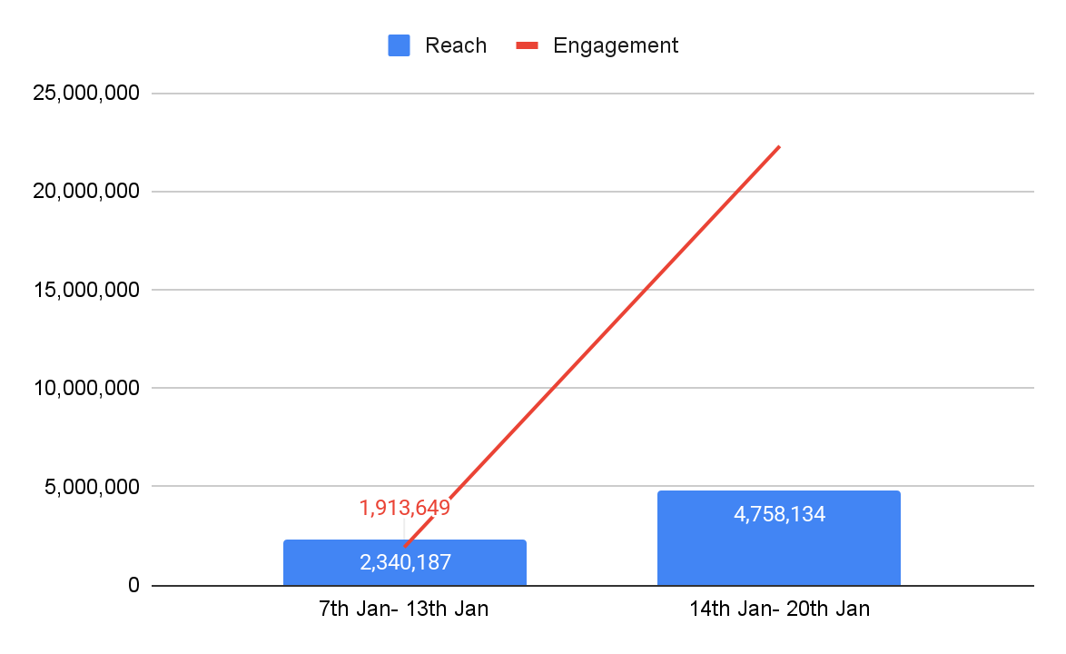
Reach and Engagement with Video Views
22,285,852
Inference: This week saw an increase in both reach and video engagement, driven by Sale-led content reaching up to 18M views, along with strong performance from the Wedding Sprint, which captured audience interest.
Date: 14th Jan- 20th Jan 2026

Slide 14
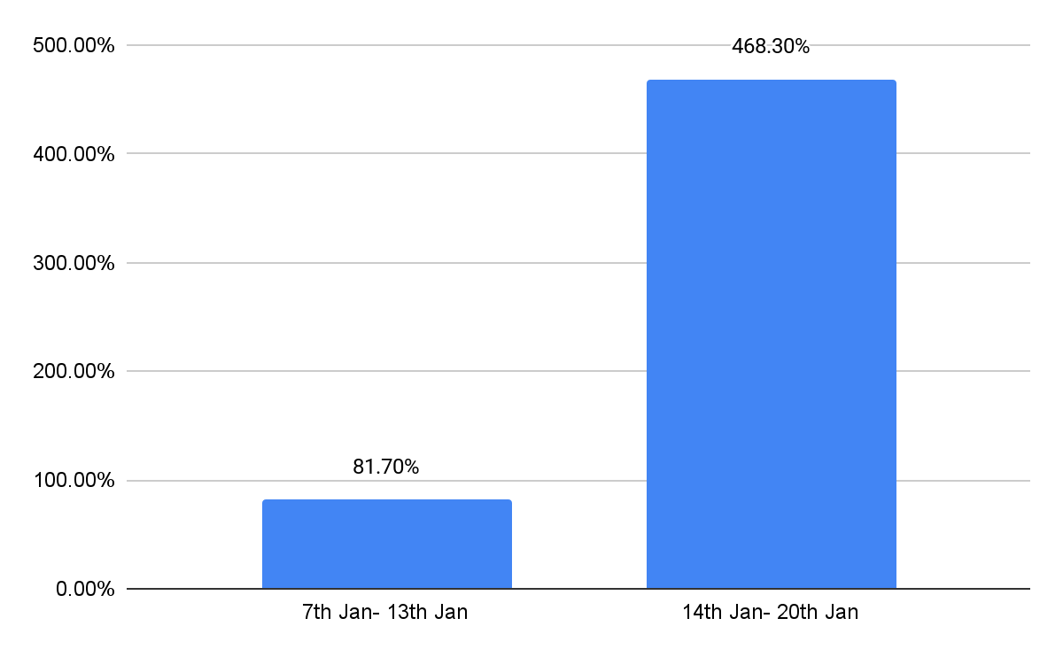
Engagement Rate (With Video Views)
Inference: This week, the engagement rate for video views increased nearly sixfold, driven by strong engagement on Sale-led content that effectively captured audience attention.
Date: 14th Jan- 20th Jan 2026

Slide 15
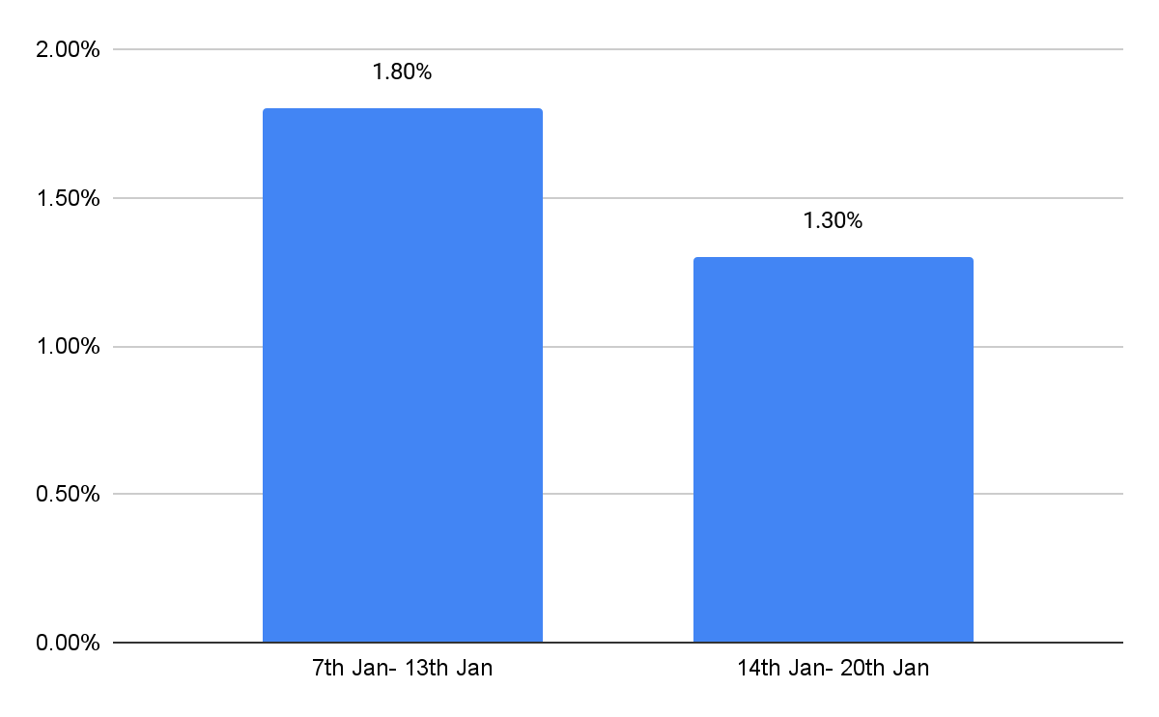
Engagement Rate (Without Video Views)
Inference: Reach and engagement rate declined this week, primarily due to lower content volume and underperformance of newness-led content. However, Sale-led content helped offset the dip and supported overall performance.
Date: 14th Jan- 20th Jan 2026

Slide 16
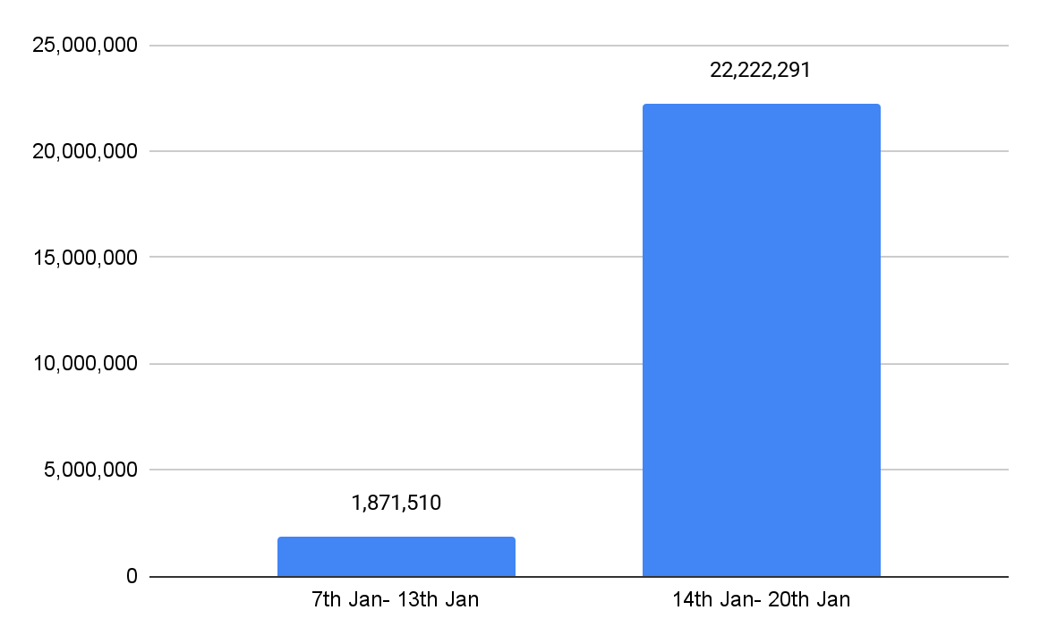
Video Views
Inference: Video views saw a significant increase this week, driven primarily by Sale-led content that crossed 18M views and captured maximum audience attention. The Wedding Sprint also performed strongly, contributing to overall viewership growth.
Date: 14th Jan- 20th Jan 2026

Slide 17
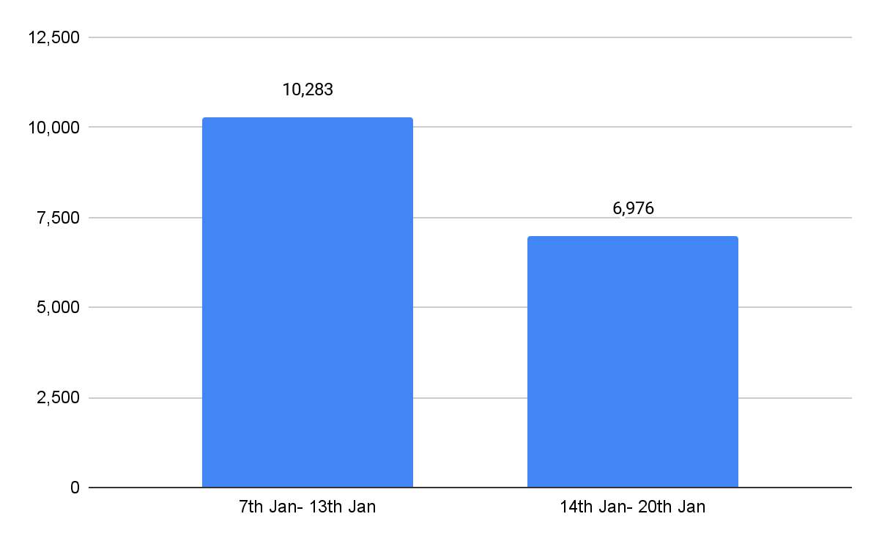
Link Clicks
Inference: Link clicks declined this week, primarily due to underperforming Tap-to-Shop stories that did not resonate strongly with audiences.
Date: 14th Jan- 20th Jan 2026

Slide 18
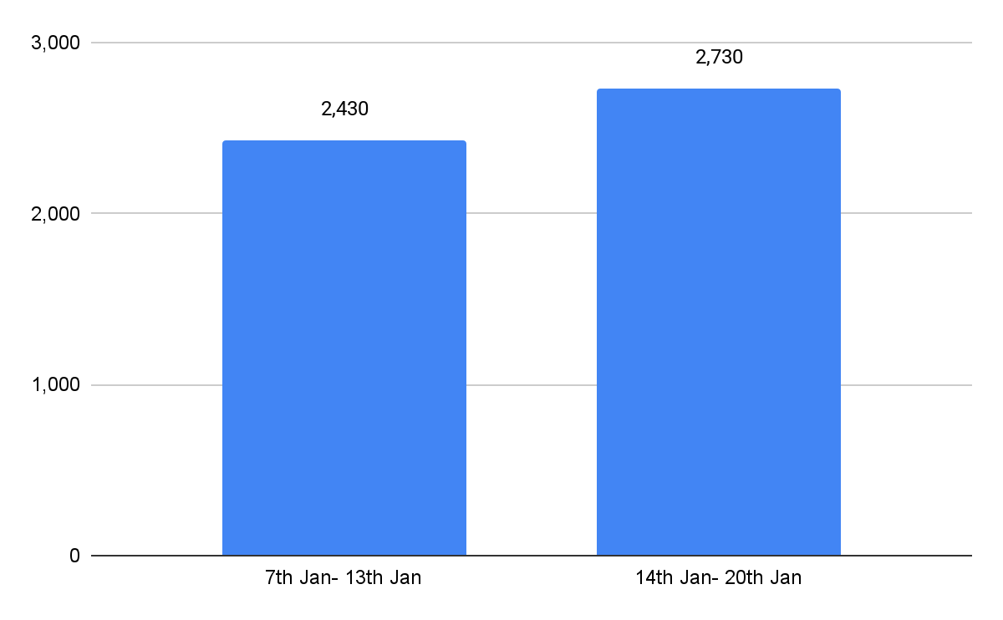
Profile Activity
Inference: Profile activity grew this week, primarily fueled by Sale-led videos that effectively directed audience traffic to the profile.
Date: 14th Jan- 20th Jan 2026

Slide 19
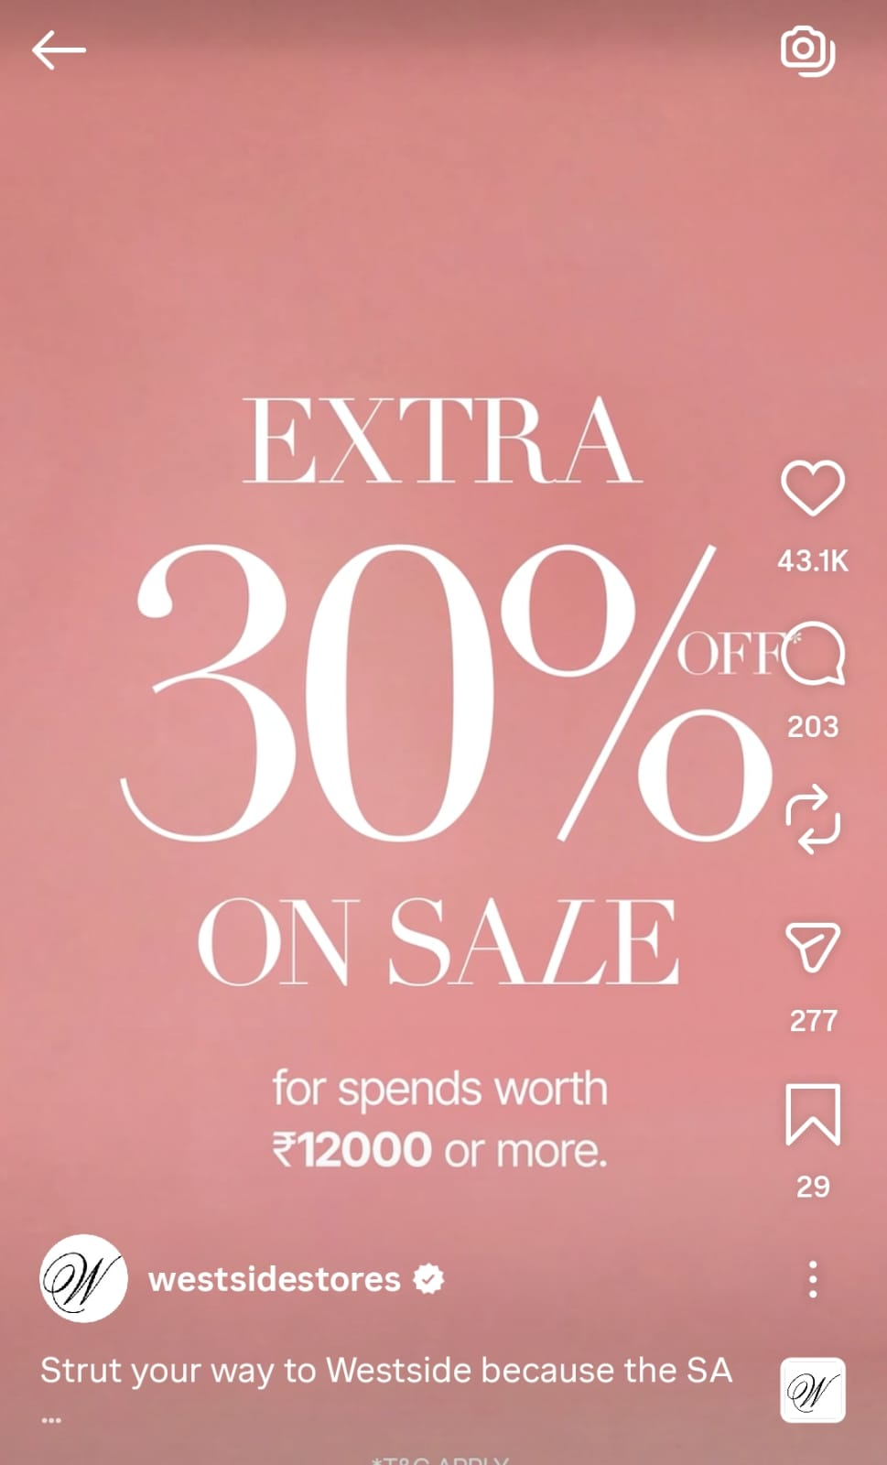
Best Performing Post on the basis of Reach
Video Views: 3,726,728
Likes: 43,109
Comments: 196
Shares: 277
Saves: 79
Engagement: 43,661
Reach: 3,045,916
Eng. Rate w/o VV: 1.43% Eng Rate w VV: 123.7%
Inference: The Sale period generated significant excitement, with the ‘30% Off’ video effectively capturing audience interest and driving strong engagement.
Date: 14th Jan- 20th Jan 2026

Slide 20
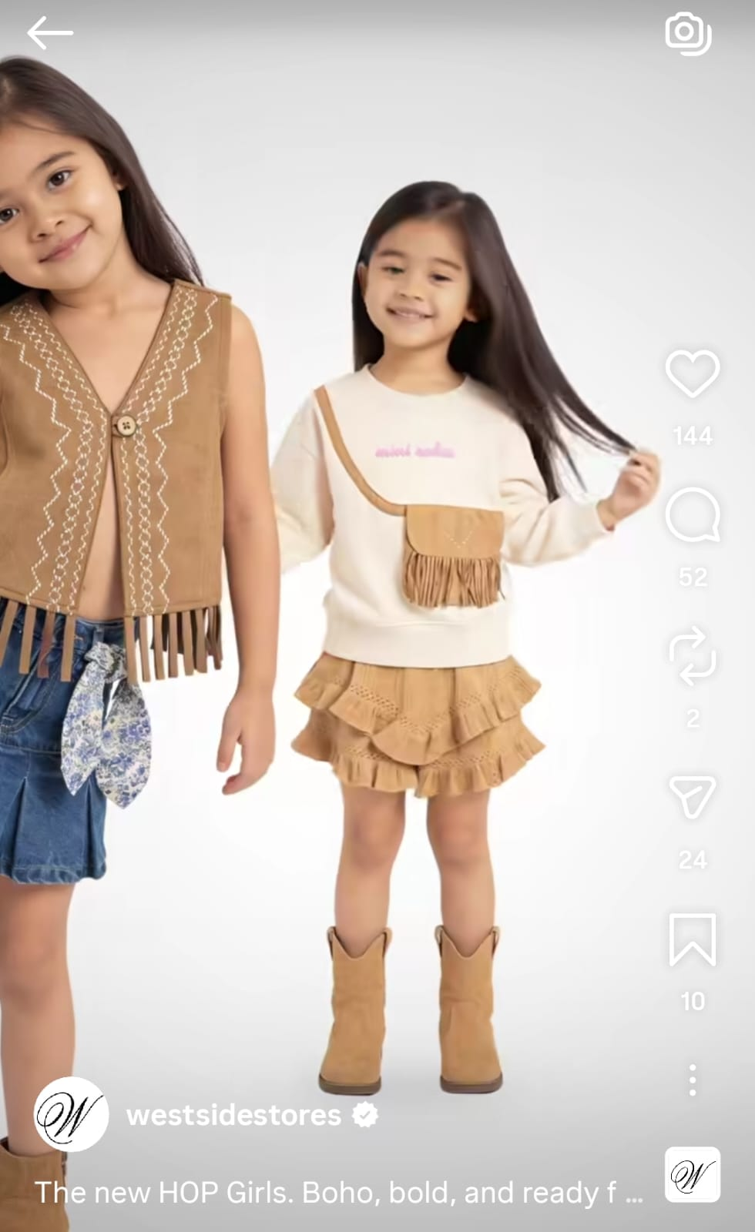
Least Performing Post on the basis of Reach
Video Views: 29,019
Likes: 116 Comments: 48
Shares: 24 Saves: 10
Engagement: 198
Reach: 17,605
Eng. Rate w/o VV: 1.12% Eng Rate w VV: 165.9%
Inference : Hop girl did not perform well mainly due to visuals which may not have aligned closely with audience expectations, resulting in reduced reach and interaction.
Date: 14th Jan- 20th Jan 2026

Slide 21
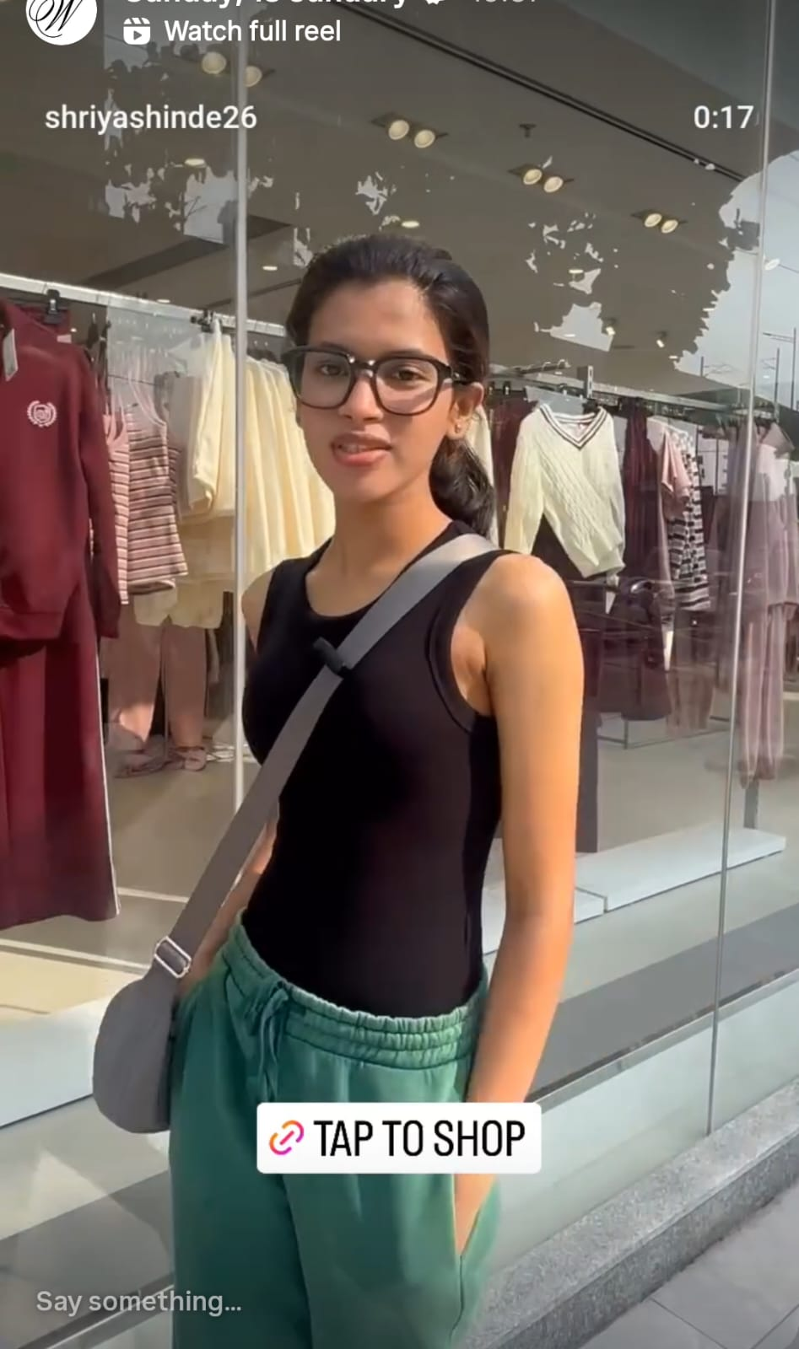
Best Performing Story on the basis of Reach
Views : 37,073
Reach : 32,062
Engagement: 513
Inference: The story featuring women discussing Lolla and showcasing the outfits performed strongly, resonating well with audiences due to its timely relevance.
Date: 14th Jan- 20th Jan 2026

Slide 22
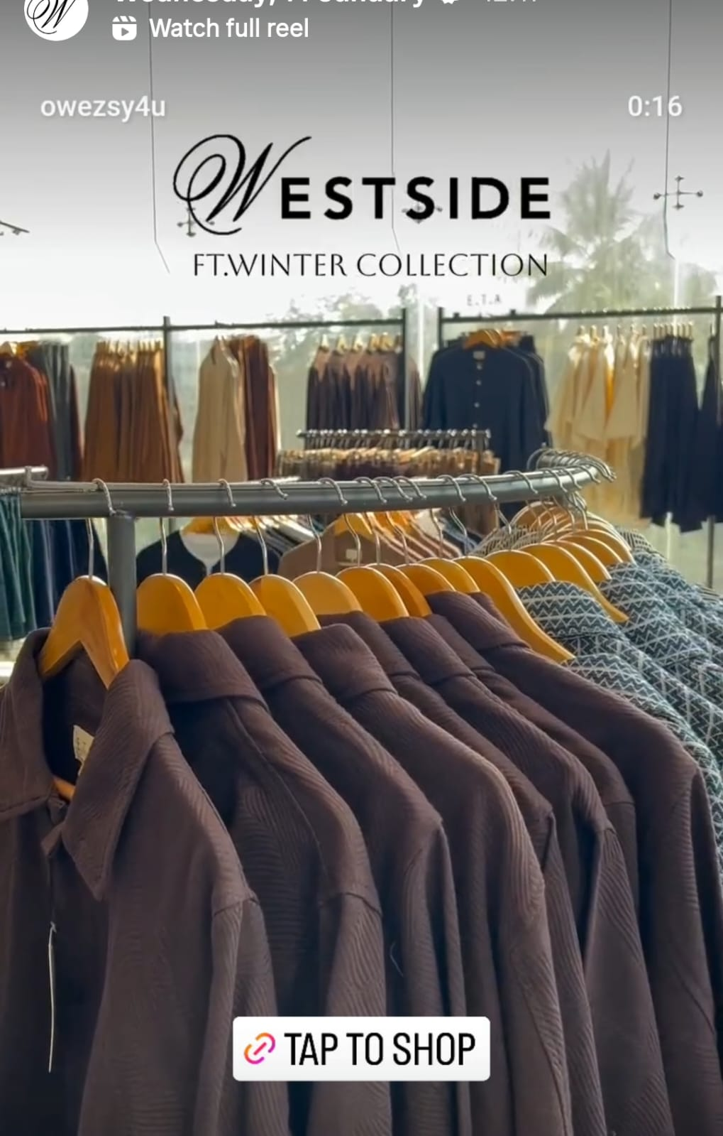
Least Performing Story on the basis of Reach
Views : 19,058
Reach : 16,035
Engagement: 322
Inference: The Men’s Winter Collection Tap-to-Shop UGC underperformed, primarily due to subpar visuals and limited audience resonance, which resulted in lower engagement and click-throughs.
Date: 14th Jan- 20th Jan 2026

Slide 23

Facebook

Slide 24
Facebook Page Analysis Summary
Particulars | 7th Jan- 13th Jan (Previous Week) | 14th Jan- 20th Jan (Current Week) | Growth
Posts | Stories | 9|44 | 9|43 | 0|-1
Page Followers | 723,607 | 724,606 | +999
Total Reach | 248,496 | 287,227 | +38,731
Total Engagement | 25,537 | 39,076 | +13,539
Total Views | 260,618 | 300,457 | +39,839
Engagement Rate without Video Views | 0.35% | 0.30%
Engagement Rate with Video Views | 10.2% | 13.6%

Slide 25
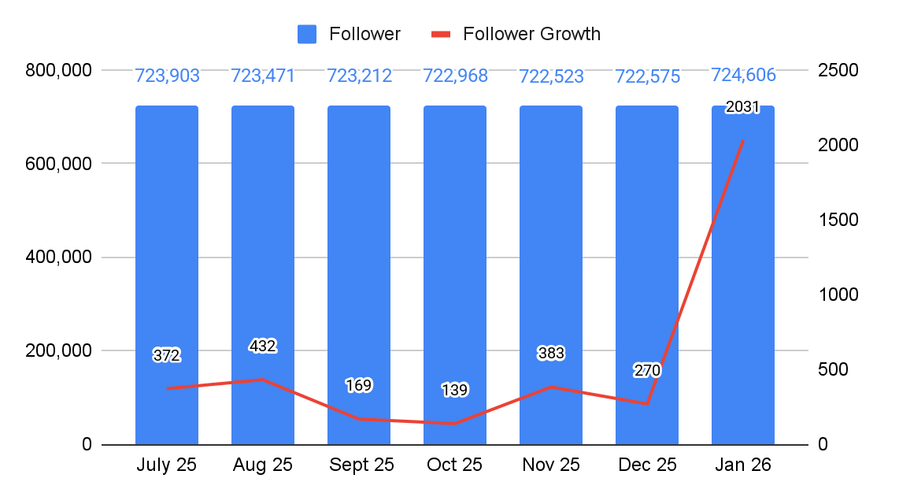
Month-on-Month Follower Growth
Date: 1st Jan- 20th Dec 2026

Slide 26
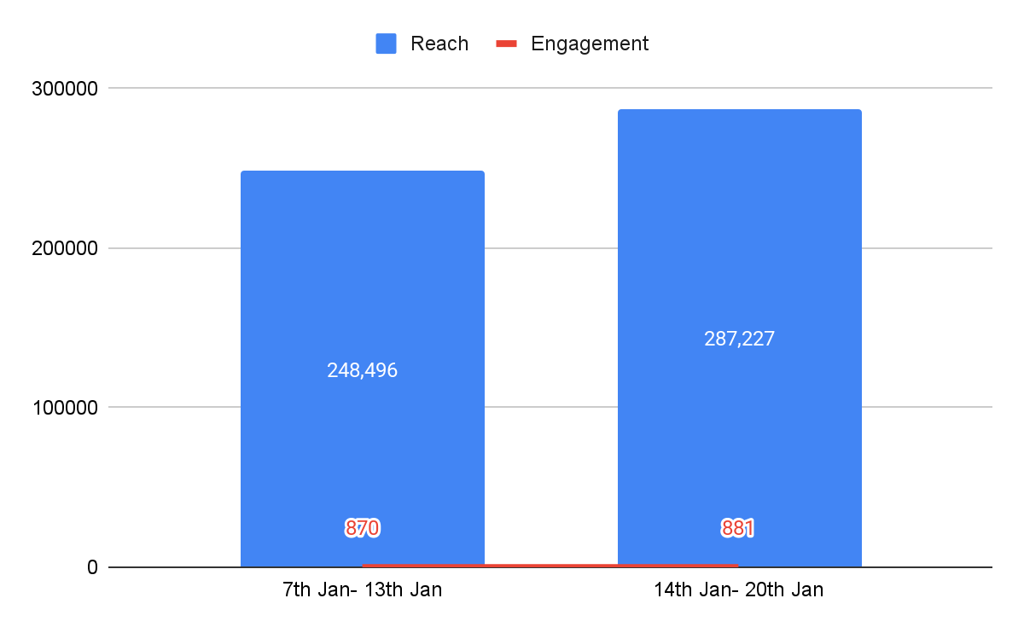
Reach and Engagement without Video Views
Date: 14th Jan- 20th Jan 2026

Slide 27
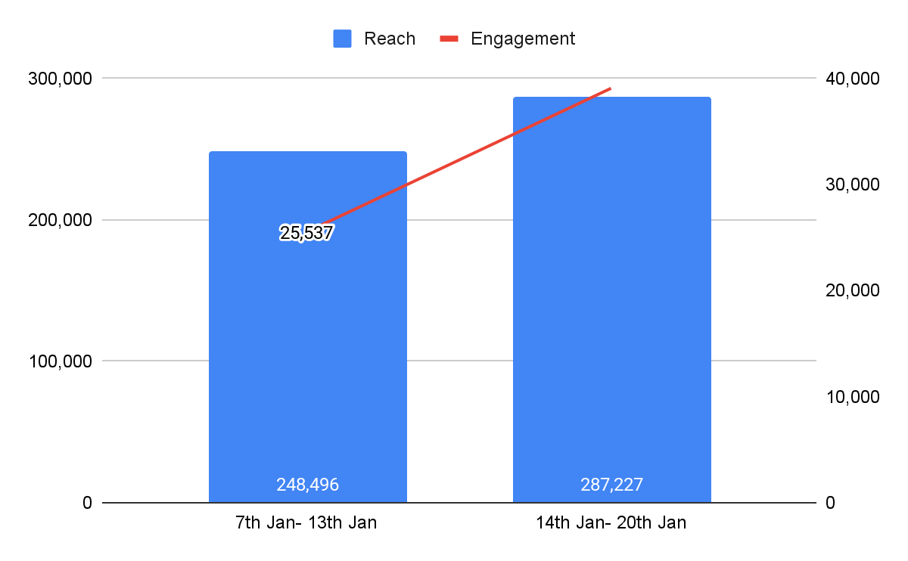
Reach and Engagement with Video Views
783,973
783,973
Date: 14th Jan- 20th Jan 2026

Slide 28
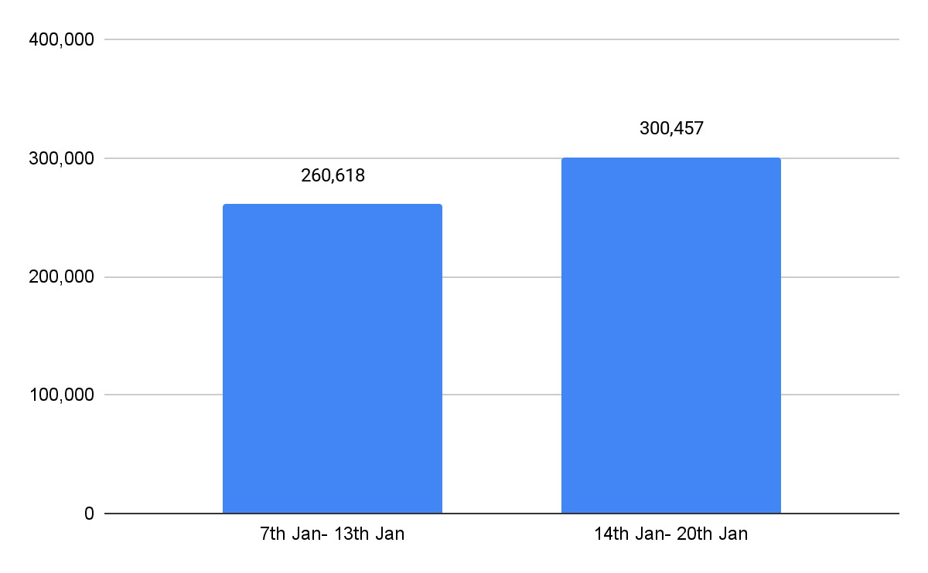
Total Views
Date: 14th Jan- 20th Jan 2026

Slide 29
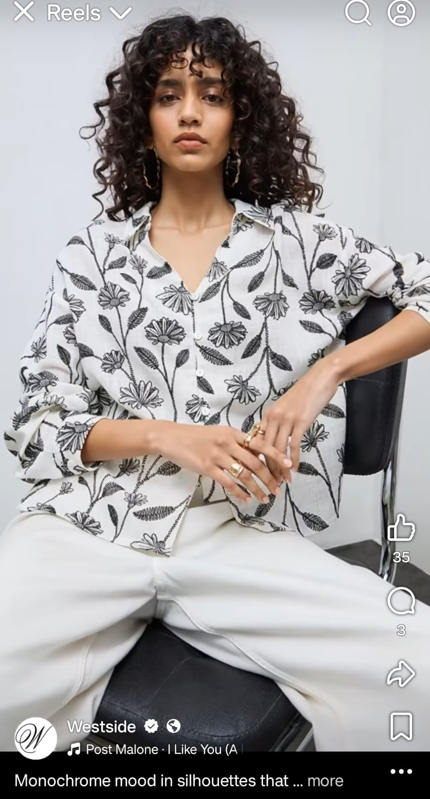
Best Performing Post on the Basis of Reach
Reach: 5,337
Engagement: 40 Engagement Rate: 0.74%
Date: 14th Jan- 20th Jan 2026

Slide 30
Least Performing Post Basis Reach
Reach: 2,395
Engagement: 11
Eng. Rate: 0.45%
Date: 14th Jan- 20th Jan 2026

Slide 31
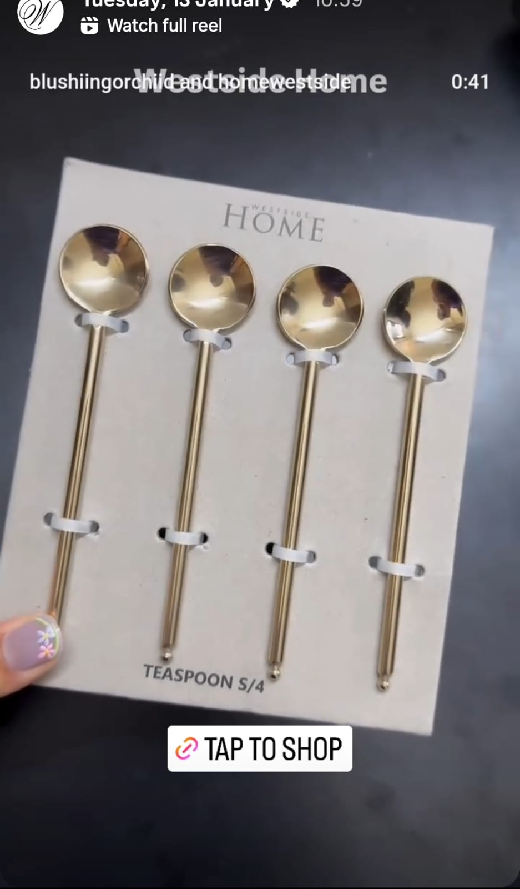
Best Performing Story Basis Reach
Reach: 12,351
Engagement: 42
Eng. Rate: 0.34%
Date: 14th Jan- 20th Jan 2026

Slide 32
Least Performing Story on the basis of Reach
Reach: 2,132
Engagement: 8 Engagement Rate: 0.37%
Date: 14th Jan- 20th Jan 2026

Slide 33

Youtube

Slide 34
Youtube Page Analysis Summary
Particulars | 7th Jan- 13th Jan (Previous Week) | 14th Jan- 20th Jan (Current Week) | Difference
Channel Subscribers | 132,674 | 132,543 | -131
YouTube Posts | 8 | 8 | 0
Video Views | 30,263 | 2,938,287 | +2,908,024
Shorts Views | 39,673 | 16,191,190 | +16,151,517
Total Views | 69,936 | 19,129,477 | +19,059,541
Watch Time (Hours) | 198.6 | 78,420.7

Slide 35
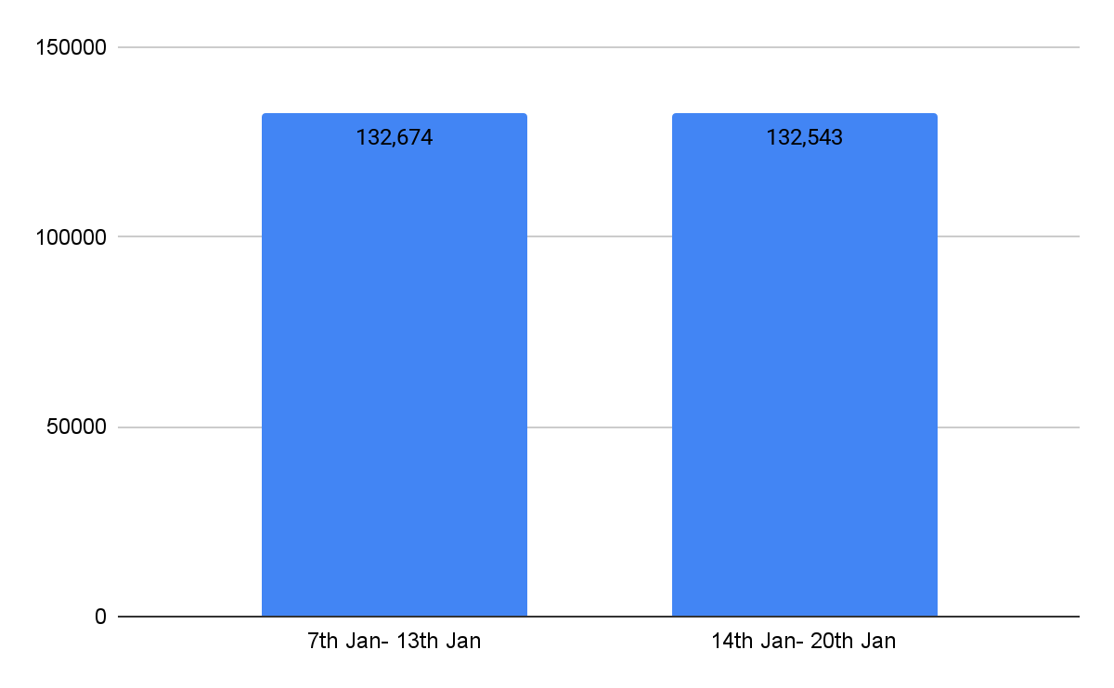
Channel Subscribers
Date: 14th Jan- 20th Jan 2026

Slide 36
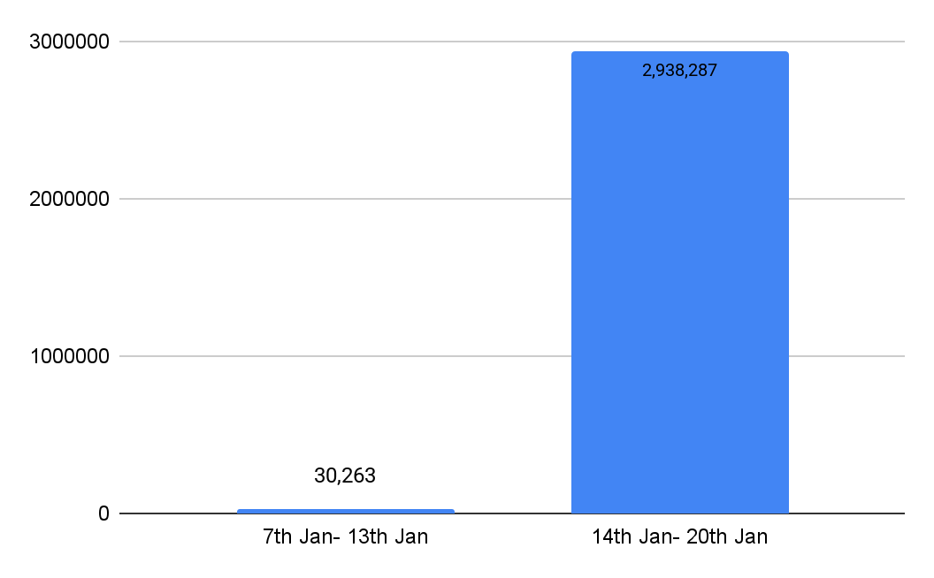
Video Views
Date: 14th Jan- 20th Jan 2026

Slide 37
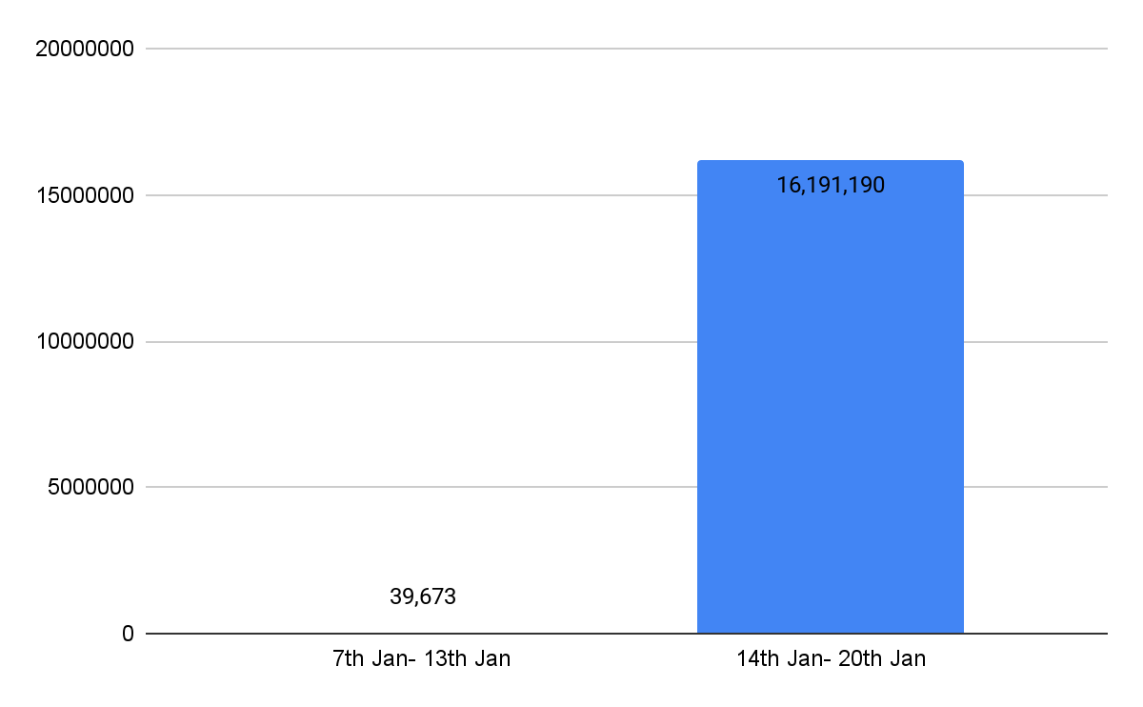
Shorts Views
Date: 14th Jan- 20th Jan 2026

Slide 38
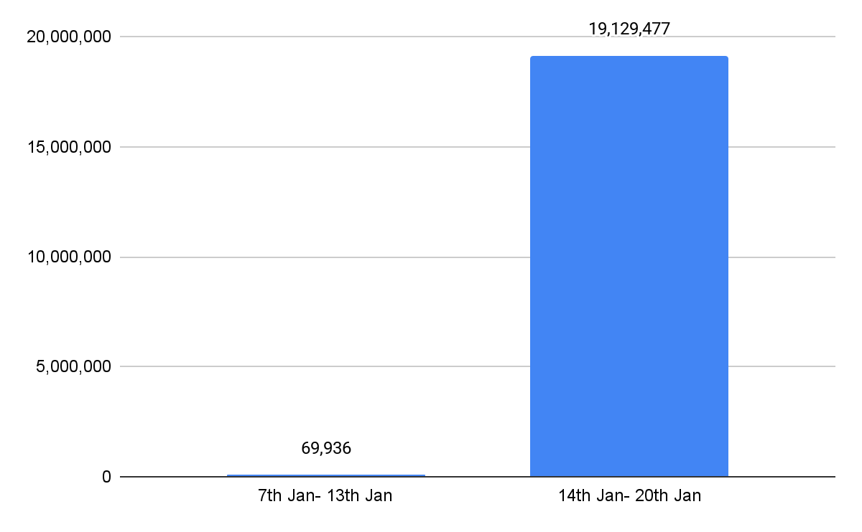
Total Views
Date: 14th Jan- 20th Jan 2026

Slide 39
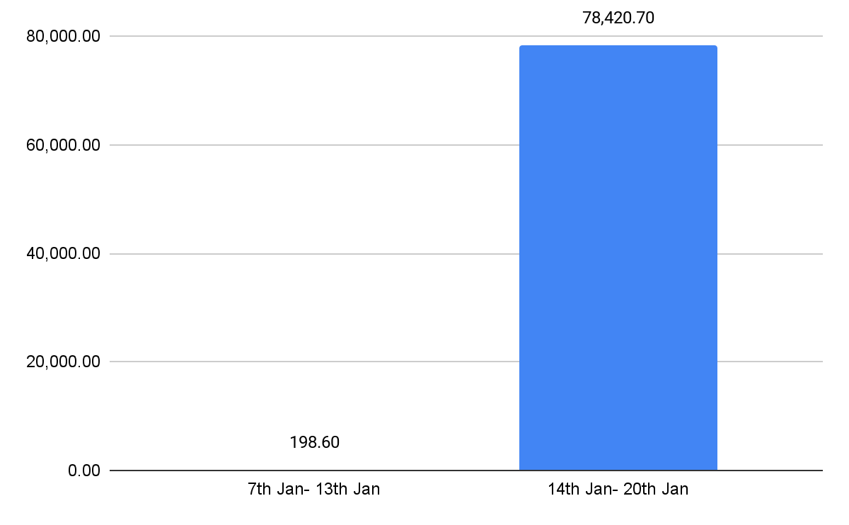
Watch Time (Hours)
Date: 14th Jan- 20th Jan 2026

Slide 40
Competitive Analysis

Slide 41

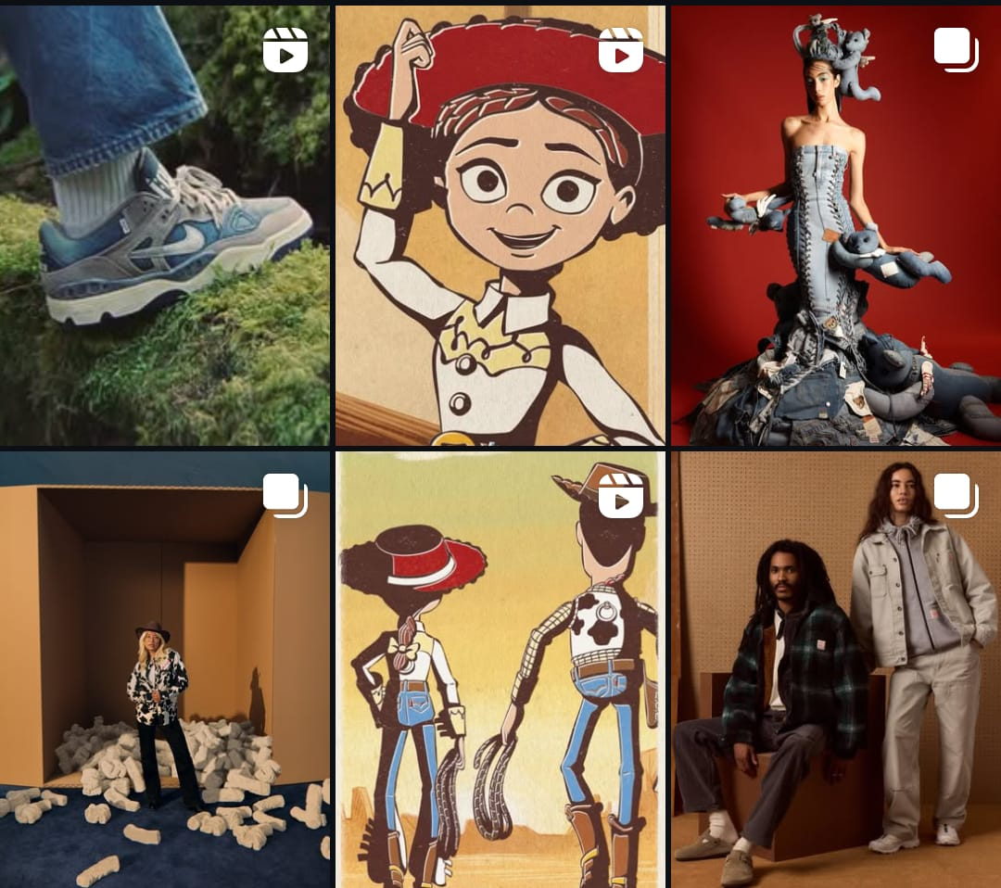
Campaign Snapshots
30th anniversary collection
Denim wear

Slide 42


Campaign Snapshots
Linen Collection

Slide 43


Campaign Snapshots
Monochromatic Summer vibes
50th Anniversary Celebration

Slide 44

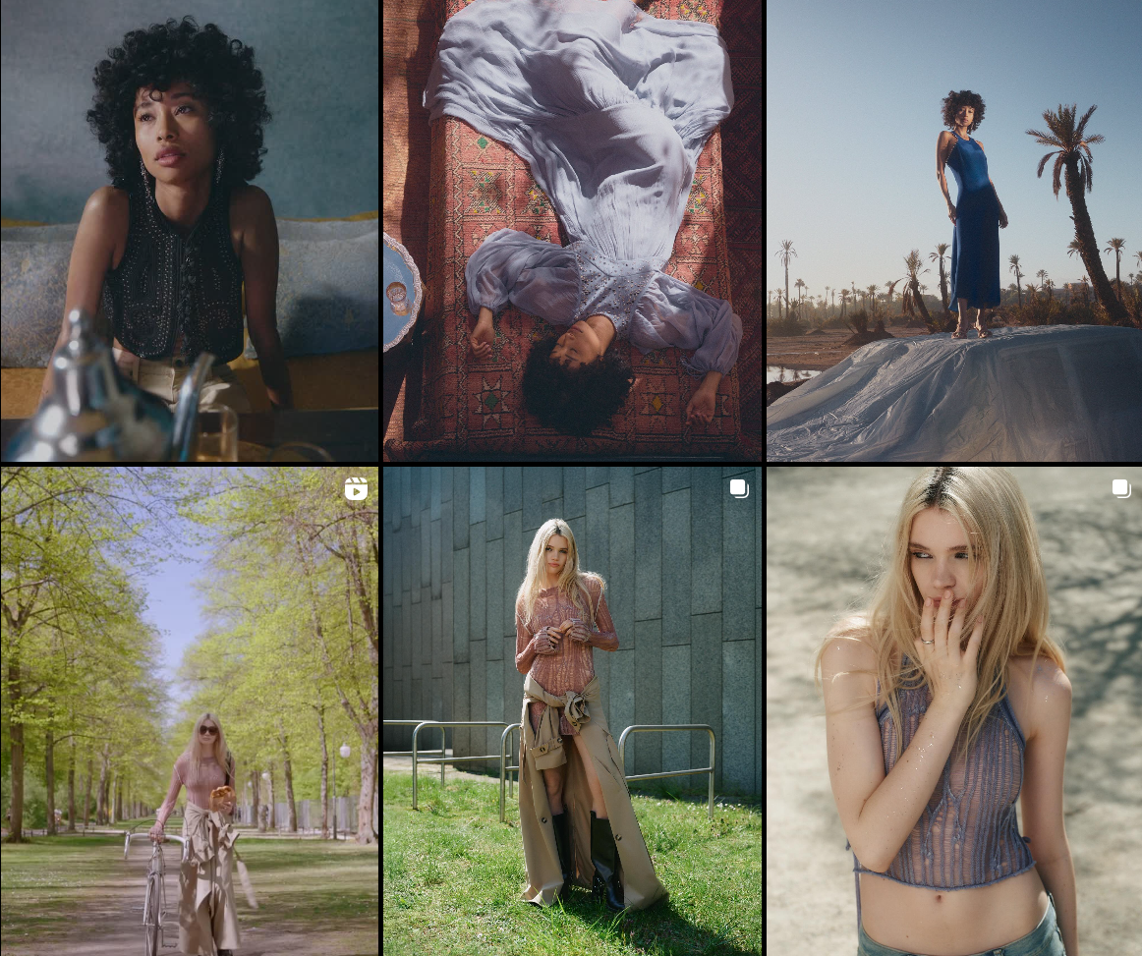
Campaign Snapshots
Studio Resort Capsule Collection

Slide 45
Instagram Posts
INSTAGRAM | Gifs (video) |  |  | Stills (image) |  |  | Overall Interactions
 | LW | TW | C%* | LW | TW | C%* | LW | TW | C%*
Total No Posts | 12 | 9 | -25% | 0 | 0 | 100.00% | 12 | 9 | -25%
Total Interactions | 26,962 | 47,743 | +77.1% | 0 | 0 | 100.00% | 26,962 | 47,743 | +77.1%
Avg interaction per post | 2,246 | 5,304 | +136% | 0 | 0 | 100.00% | 2,246 | 5,304 | +136%
Total Reach | 1,436,380 | 3,834,148 | +166.9% | 0 | 0 | 100.00% | 1,436,380 | 3,834,148 | +166.9%
Video View Rate | 130.2% | 579.5% |  | 0 | 0 | 0.00% | 130.2% | 579.5%
Engagement Rate without video views | 1.8% | 1.3% |  | 0 | 0 | 100.00% | 1.8% | 1.3%
Date: 14th Jan- 20th Jan 2026

Slide 46
Facebook Posts
Facebook | Gifs (video) |  |  | Stills (image) |  |  | Overall Interactions
 | LW | TW | C%* | LW | TW | C%* | LW | TW | C%*
Total No Posts | 9 | 9 | - | 0 | 0 | nil | 9 | 9 | -
Total Interactions | 238 | 239 | +0.42% | 0 | 0 | nil | 238 | 239 | +0.42%
Avg interaction per post | 26 | 26 | - | 0 | 0 | nil | 26 | 26 | -
Total Reach | 22,919 | 34,212 | +49.3% | 0 | 0 | nil | 22,919 | 34,212 | +49.3%
Video View Rate | 107.6% | 111.6% |  | 0 | 0 | nil | 107.6% | 111.6%
Engagement Rate without video views | 1.03% | 0.3% |  | 0 | 0 | nil | 1.03% | 0.3%
Date: 14th Jan- 20th Jan 2026

Slide 47
Stories
Instagram Stories | LW | TW | Change
Total Interactions | 15,177 | 15,818 | +4.2%
Average Interaction per story | 344 | 376 | +9.3%
No of Stories | 44 | 42 | -4.5%
Facebook Stories | LW | TW | Change
Total Interactions | 632 | 642 | +1.5%
Average Interaction per story | 14 | 15 | +7.1%
No of Stories | 44 | 43 | -2.2%
Date: 14th Jan- 20th Jan 2026

Slide 48
Observations
• Sale videos, including ‘20% Off’ and ‘30% Off’, consistently captured audience attention, generated high video views (up to 18M), and boosted engagement and profile activity.
• The Wedding Sprint campaign resonated well with audiences, contributing significantly to reach and video engagement.
• Stories featuring Lolla outfits and women discussing them performed well due to timely relevance and context, showing the importance of aligning content with audience interest.
• Reach and engagement grew significantly this week, indicating strong content performance.
• Link clicks decreased this week, likely due to lower engagement on Tap to Shop UGC’s.

Slide 49
Recommendations
Leverage High-Performing Influencers Strategically
Partner with influencers who align closely with the target audience, while avoiding overlapping or repetitive collaborations to prevent content fatigue.
Align Event and Timely Content with Audience Interests
Ensure that event- or holiday-led stories (e.g., Lolla, Holi) are contextually relevant, product-focused, and visually engaging to drive stronger audience resonance.
Capitalize on High-Performing Campaigns for Follower Growth
Use campaigns like Wedding Sprint and HOP Kids strategically to maintain steady follower growth and sustain engagement during high-interest periods.

Slide 50
Thank You

